Slide 1
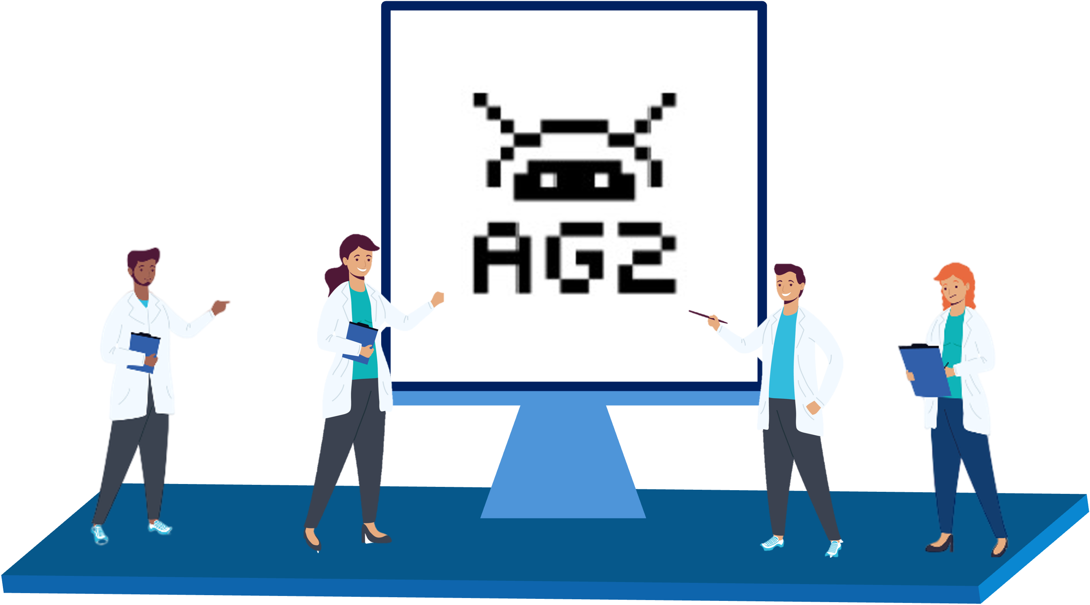

Sharif LLM Agent Hackathon
Khordad 6, 1404
Building LLM-powered
multiagent systems with AG2
Alireza Ghafarollahi
Massachusetts Institute of Technology
Notes:
Thank you very much. I am very excited to be here today.
Before I start, I would like to take this moment to thank Professors Bill Curtin and Markus Buehler, my PhD and postdoctoral advisors, for their invaluable support and guidance.

Slide 2
Overview
A pre-programmed multi-agent system with Python
Build your first multi-agent system
Fully automated multi-agent system (AG2)
Basic Concepts
LLM Configuration
ConversableAgent
Human in the Loop
Agent Orchestration
Tools
Structured Outputs
Agent Orchestration Deep Dive
Two Agent Chat
Sequential Chat
Group Chats
Tools and functions
Context Variables
Handoffs
Orchestration Patterns (if time allowed)

Slide 3
A pre-programmed multi-agent system with Python

Slide 4
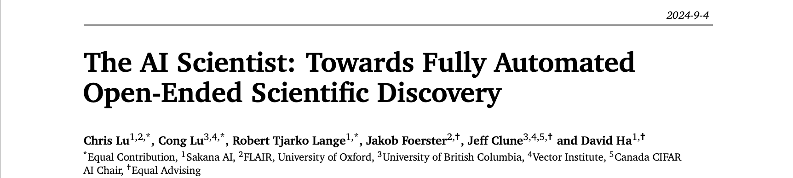
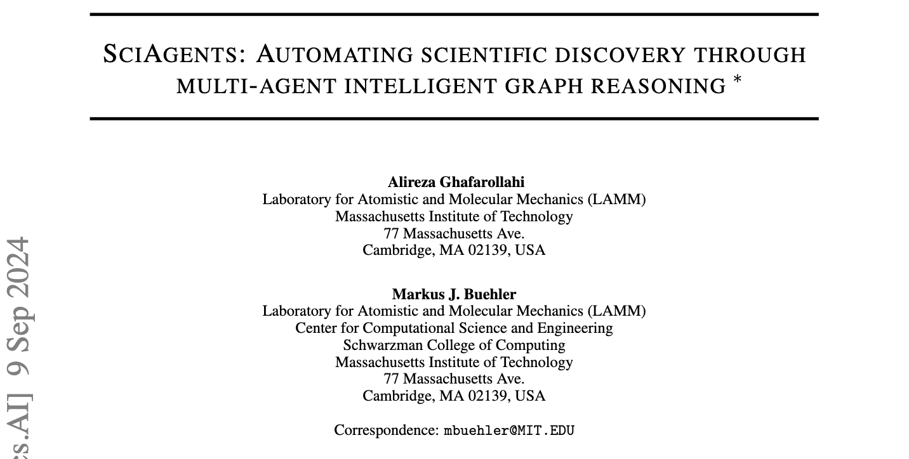
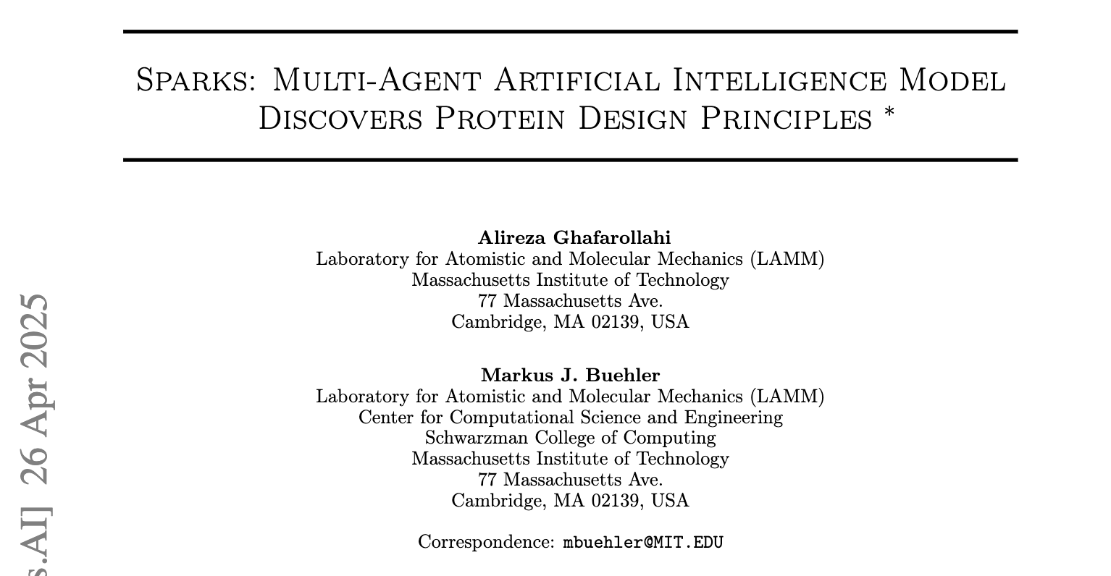
A pre-programmed multi-agent system with Python
Pre-programmed sequence of interactions between agents
More consistency and reliability
Less flexibility
No human in the loop

Slide 5
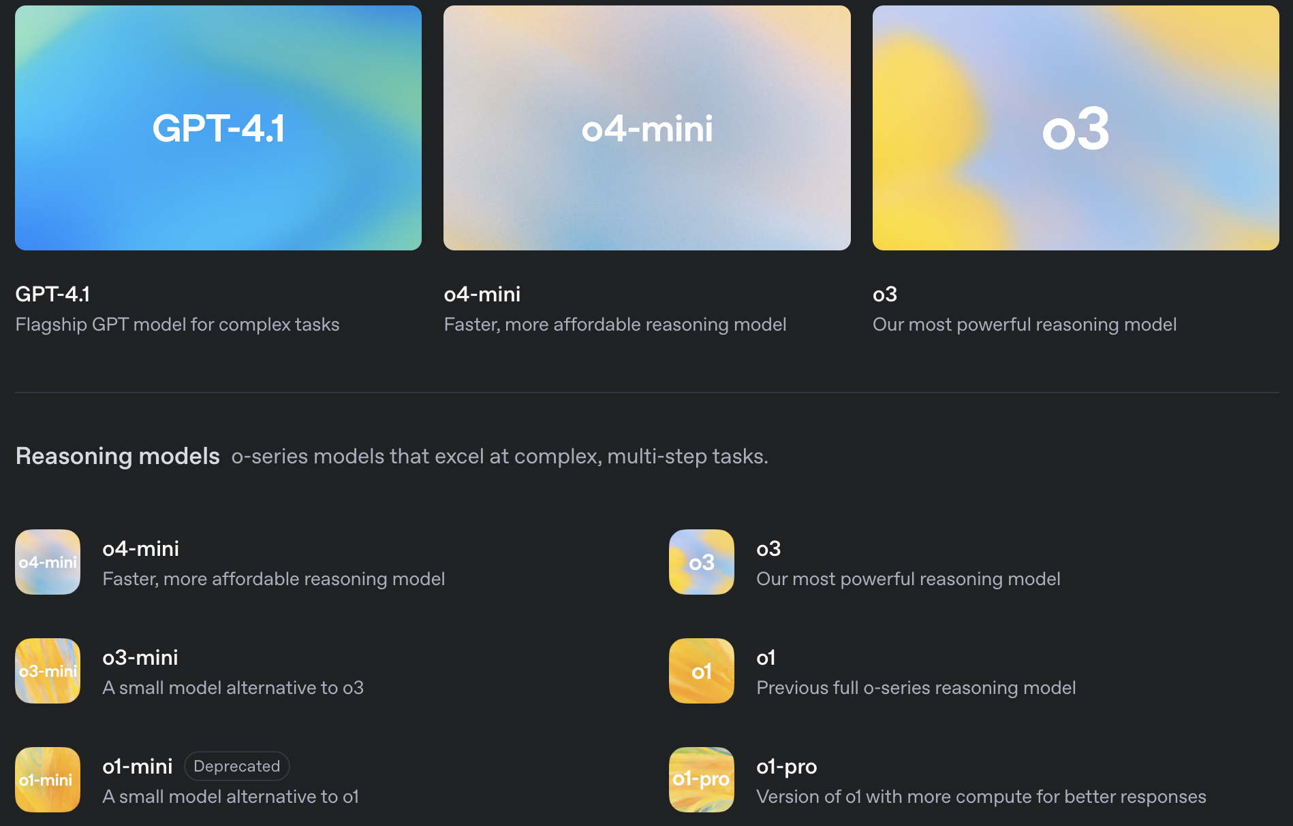
Building your first agent
Agents use LLMs as key components to understand and react
OpenAI models
client = OpenAI()
response = client.chat.completions.create(
model,
messages,
temperature,
max_completion_tokens,
)
content = response.choices[0].message.content

Slide 6
Building your first agent
messages=[
{“role”: “user”, “content”: “prompt_1”}
]
prompt
agent’s profile
+
user’s query
messages
msg_history
response

Slide 7
Now let’s add another agent that interacts with the first agent
messages=[
{“role”: “user”, “content”: “prompt_1”},
{“role”: “assistant”, “content”: “response_1”},
{“role”: “user”, “content”: “prompt_2”},]
msg_history
msg_history (old prompt+old response)
messages
msg_history
new prompt
new response

Slide 8
AG2: Building fully automated multi-agent systems

Slide 9
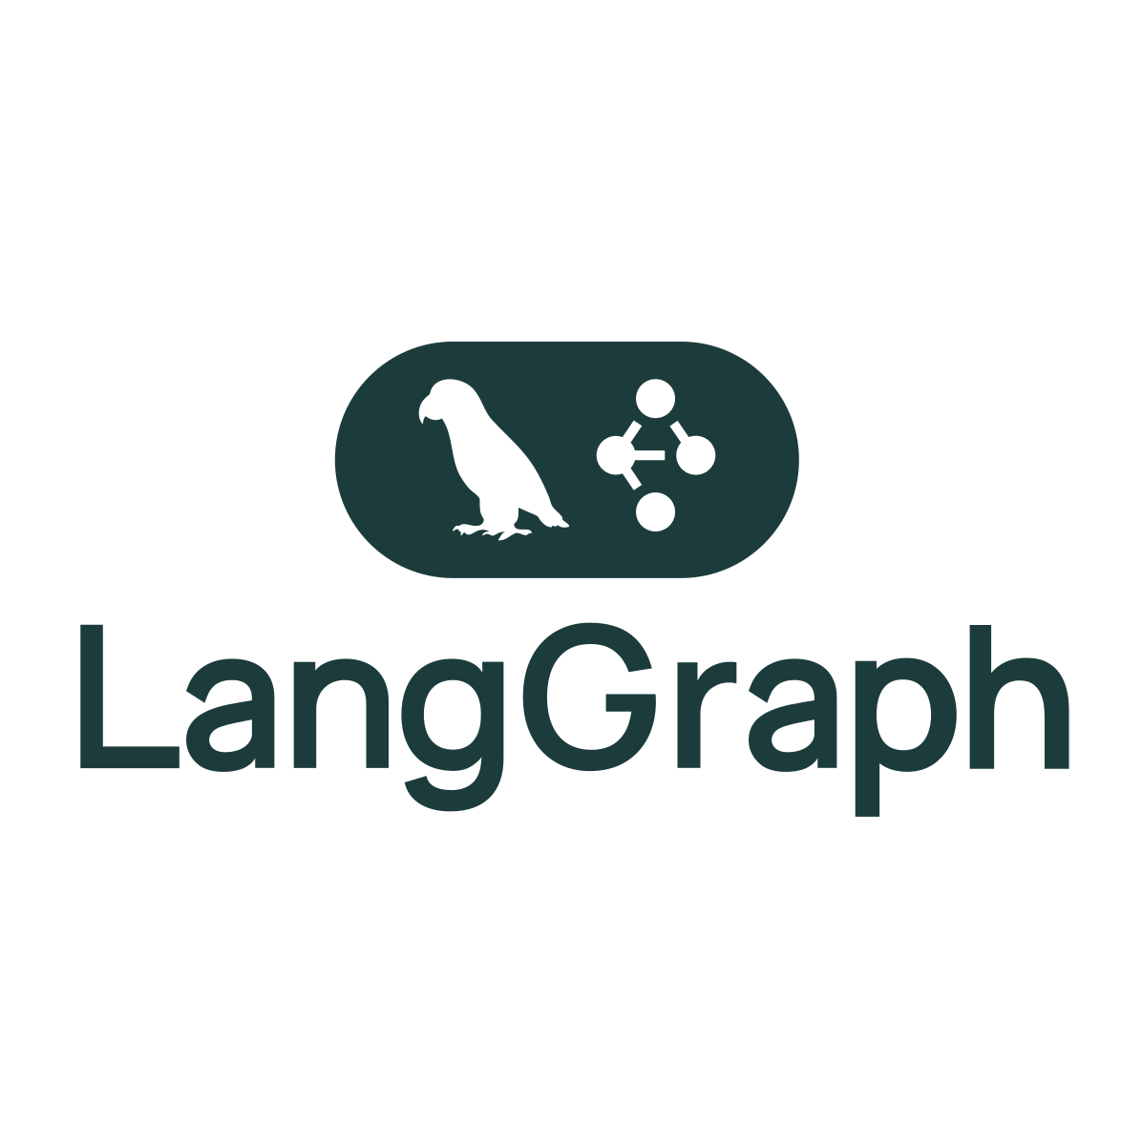
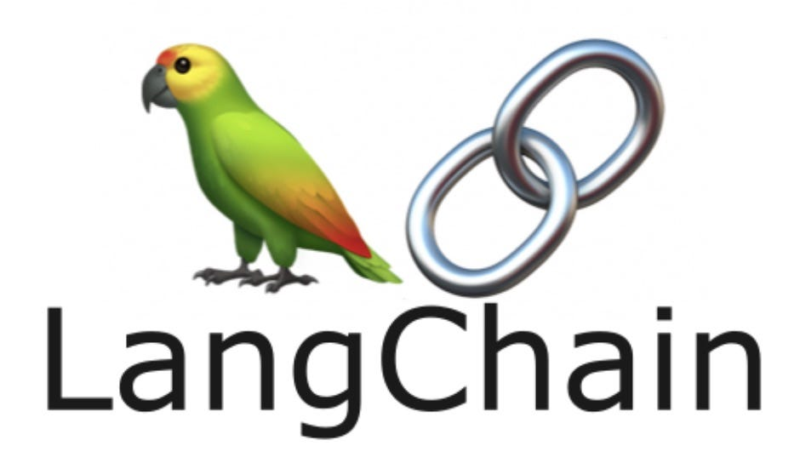





Multi-agent frameworks

Slide 10
Multi-agent frameworks
Add something here!

Slide 11
AG2
Installing AG2
Basic Concepts
LLM Configuration
ConversableAgent
Human in the Loop
Agent Orchestration
Tools
Structured Outputs

Slide 12
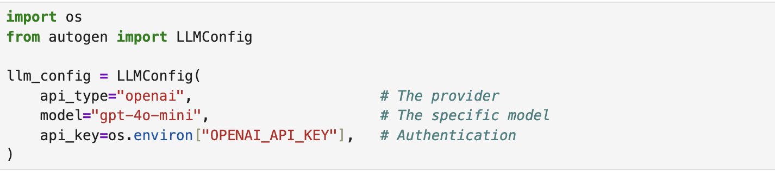
LLM configuration
LLM Configuration controls how an agent:
Connects to and authenticates with language model providers
Selects models and sets parameters
Thinks, reasons, and generates responses
AG2 supports a variety of LLM providers
Cloud Models: OpenAI, Anthropic, Google (Gemini), Amazon (Bedrock), Mistral AI, Cerebras, Together AI, and Groq
Local Models: Ollama, LiteLLM, and LM Studio

Slide 13
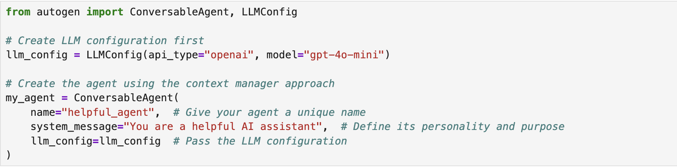
ConversableAgents: Building Intelligent Agents
The ConversableAgent is the fundamental building block of AG2.
With an LLM configuration providing its thinking power, a ConversableAgent can:
Communicate with other agents and humans
Process information and generate responses
Follow instructions defined in its system message
Execute tools and functions when needed
Notes:
GO to

Slide 14
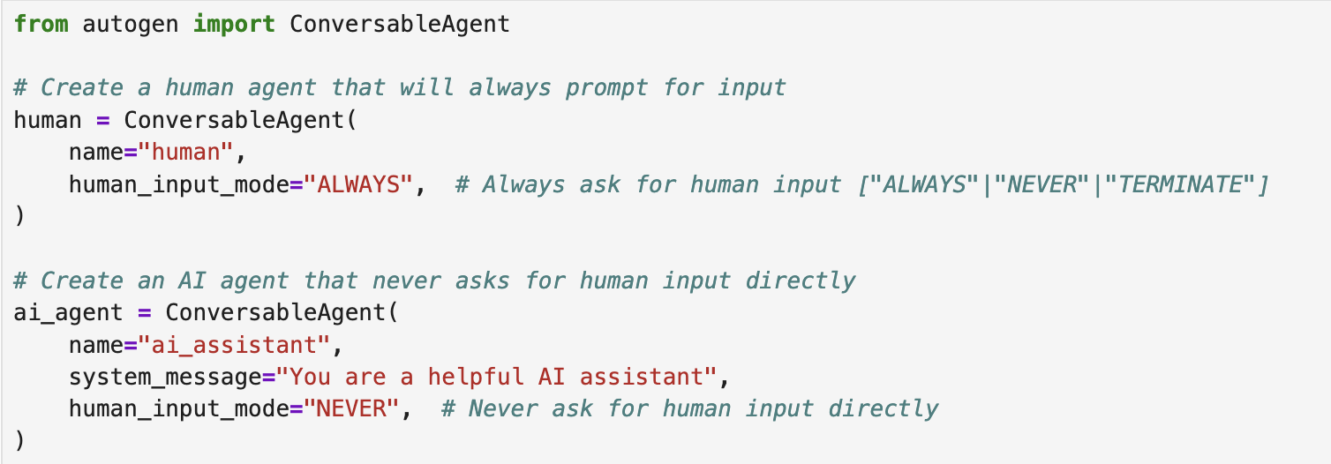
Human in the loop: Adding human oversight
A powerful pattern that enables AG2 agents to collaborate with humans throughout the workflow.
Humans can:
Oversee the entire process
Intervene when necessary
Inject new queries dynamically
Notes:
GO to

Slide 15
ConversableAgents: Building Intelligent Agents
In Notebook 2 we’ll see how to:
load and set openai api key
Define LLM configuration
Build our first agent with AG2
Interact with the agent using run() and process()
add human in the loop capacity
Notes:
GO to

Slide 16
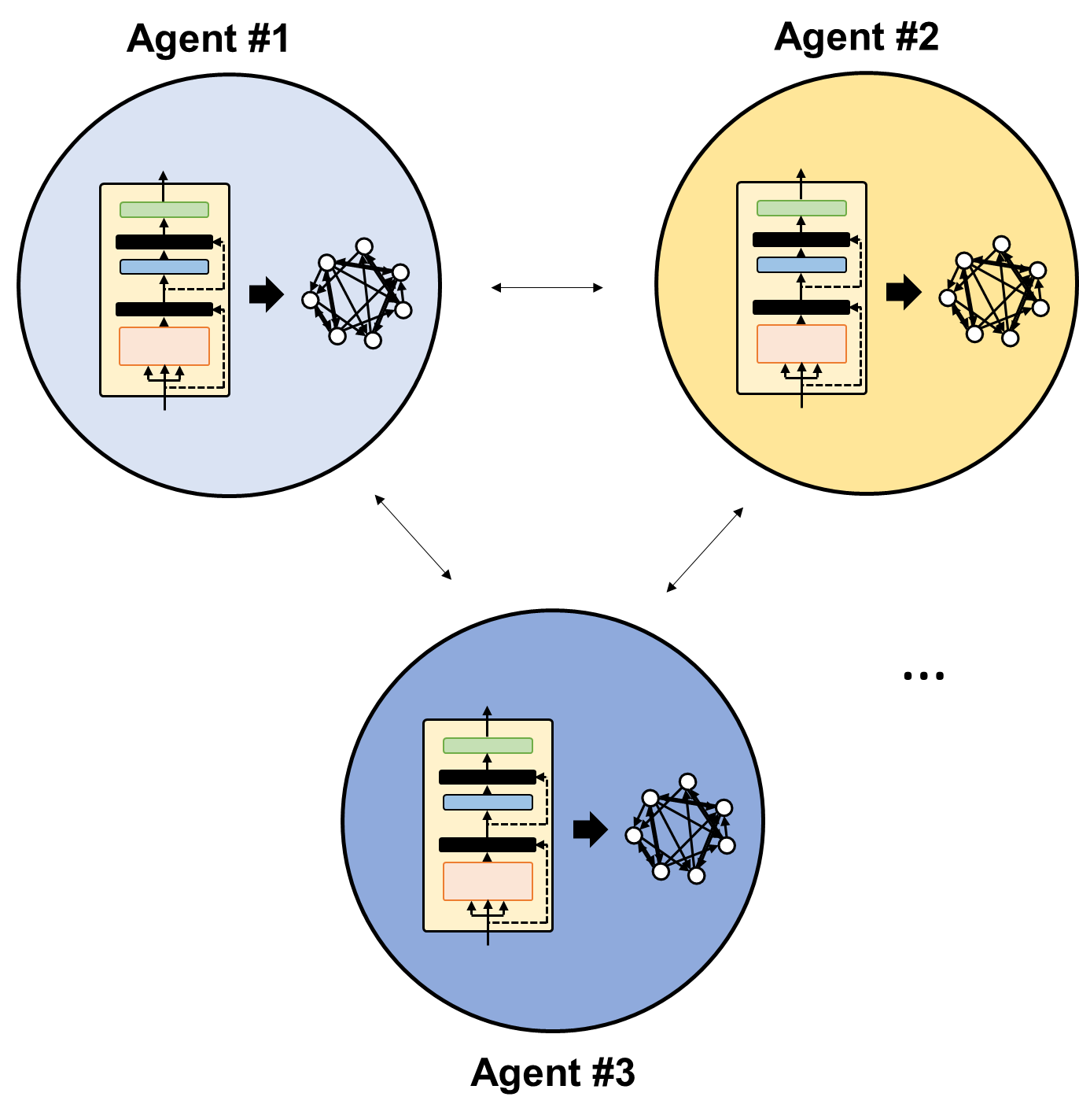


Agent Orchestration: Coordinating Multiple Agents
Why multi-agent systems?
Using multiple "simple" unitary components to build out higher complexity
Improving LLMs through reflection, planning, and tool use strategies to produce more accurate results
Interact to model “thought” – iterations, critique, improvements
T. Dreyer et al. PNAS (2024)
We find that when ants work in groups, their performances rise significantly

Slide 17
Agent Orchestration: Coordinating Multiple Agents
In multi-agent systems, specialized agents collaborate dynamically to achieve complex workflows.
Implementing a group chat in AG2 is a simple three-step process
First, build the agents
Then, create a pattern that defines how agents will interact
Finally, initialize the group chat using the pattern

Slide 18
Patterns
The pattern defines the orchestration logic - which agents are involved, who speaks first, and how to transition between agents.
AG2 provides several pre-defined patterns to choose from:
DefaultPattern: A minimal pattern for simple agent interactions where the handoffs and transitions needs to be explicitly defined
AutoPattern: Automatically selects the next speaker based on conversation context
RoundRobinPattern: Agents speak in a defined sequence
RandomPattern: Randomly selects the next speaker
ManualPattern: Allows human selection of the next speaker
The easiest pattern to get started with is the AutoPattern, where a group manager agent automatically selects agents to speak by evaluating the messages in the chat and the descriptions of the agents.

Slide 19
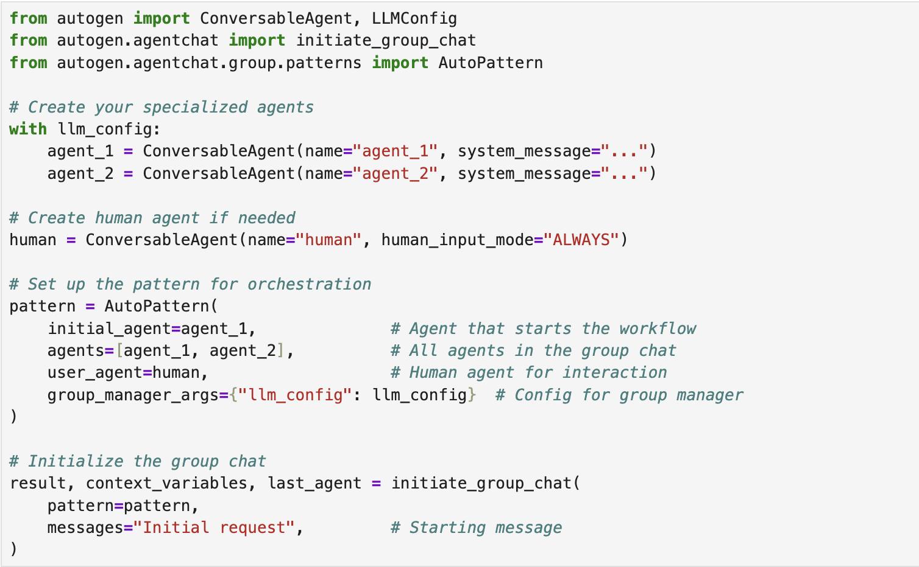
Pattern implementation

Slide 20
Agent Orchestration: Coordinating Multiple Agents
In Notebook 3 we’ll see how to build a multi-agent system with AutoPattern.

Slide 21
Tools: Extending Agent Capabilities
Tools provide a structured way for agents to interact with the outside world.
Think of tools as specialized functions that agents can choose to use when appropriate.
With tools we provide AI with ability to generate its own data or retrieve knowledge from different sources
Tool usage in AG2 follows a two-step process:
Selection: An agent (driven by its LLM) decides which tool is appropriate based on the given task
Execution: A separate executor agent invokes the tool and returns the results

Slide 22
Multi-agent system with tools
Empowering a group chat in AG2 with tools
Define the tools
Then, build the agents and assign the tools
Then, create a pattern that defines how agents will interact
Finally, initialize the group chat using the pattern

Slide 23
Agent Orchestration: Coordinating Multiple Agents
In Notebook 4, we’ll see how to add tools to our multi-agent system.

Slide 24
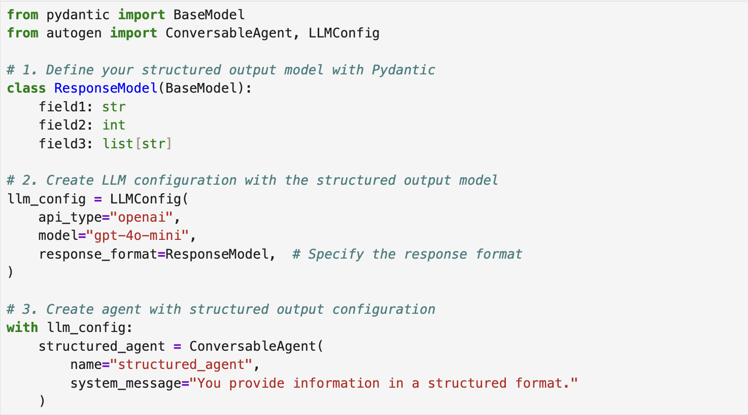
Structured Outputs: Ensuring Consistent Responses
Producing results in exactly the prescribed structured format

